Slide 1
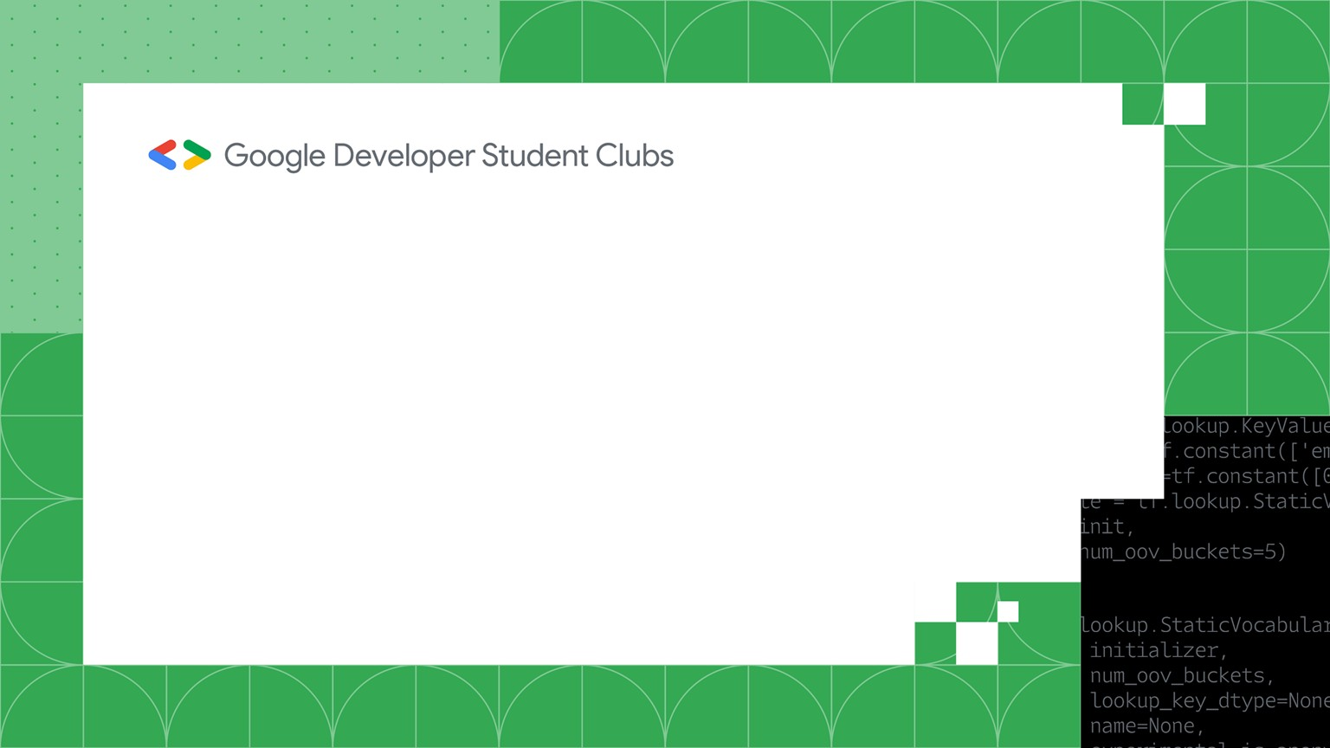


GIT AND GITHUB
C.V. Raman Global University
Bringing the world together
www.codeboosters.in

Slide 2
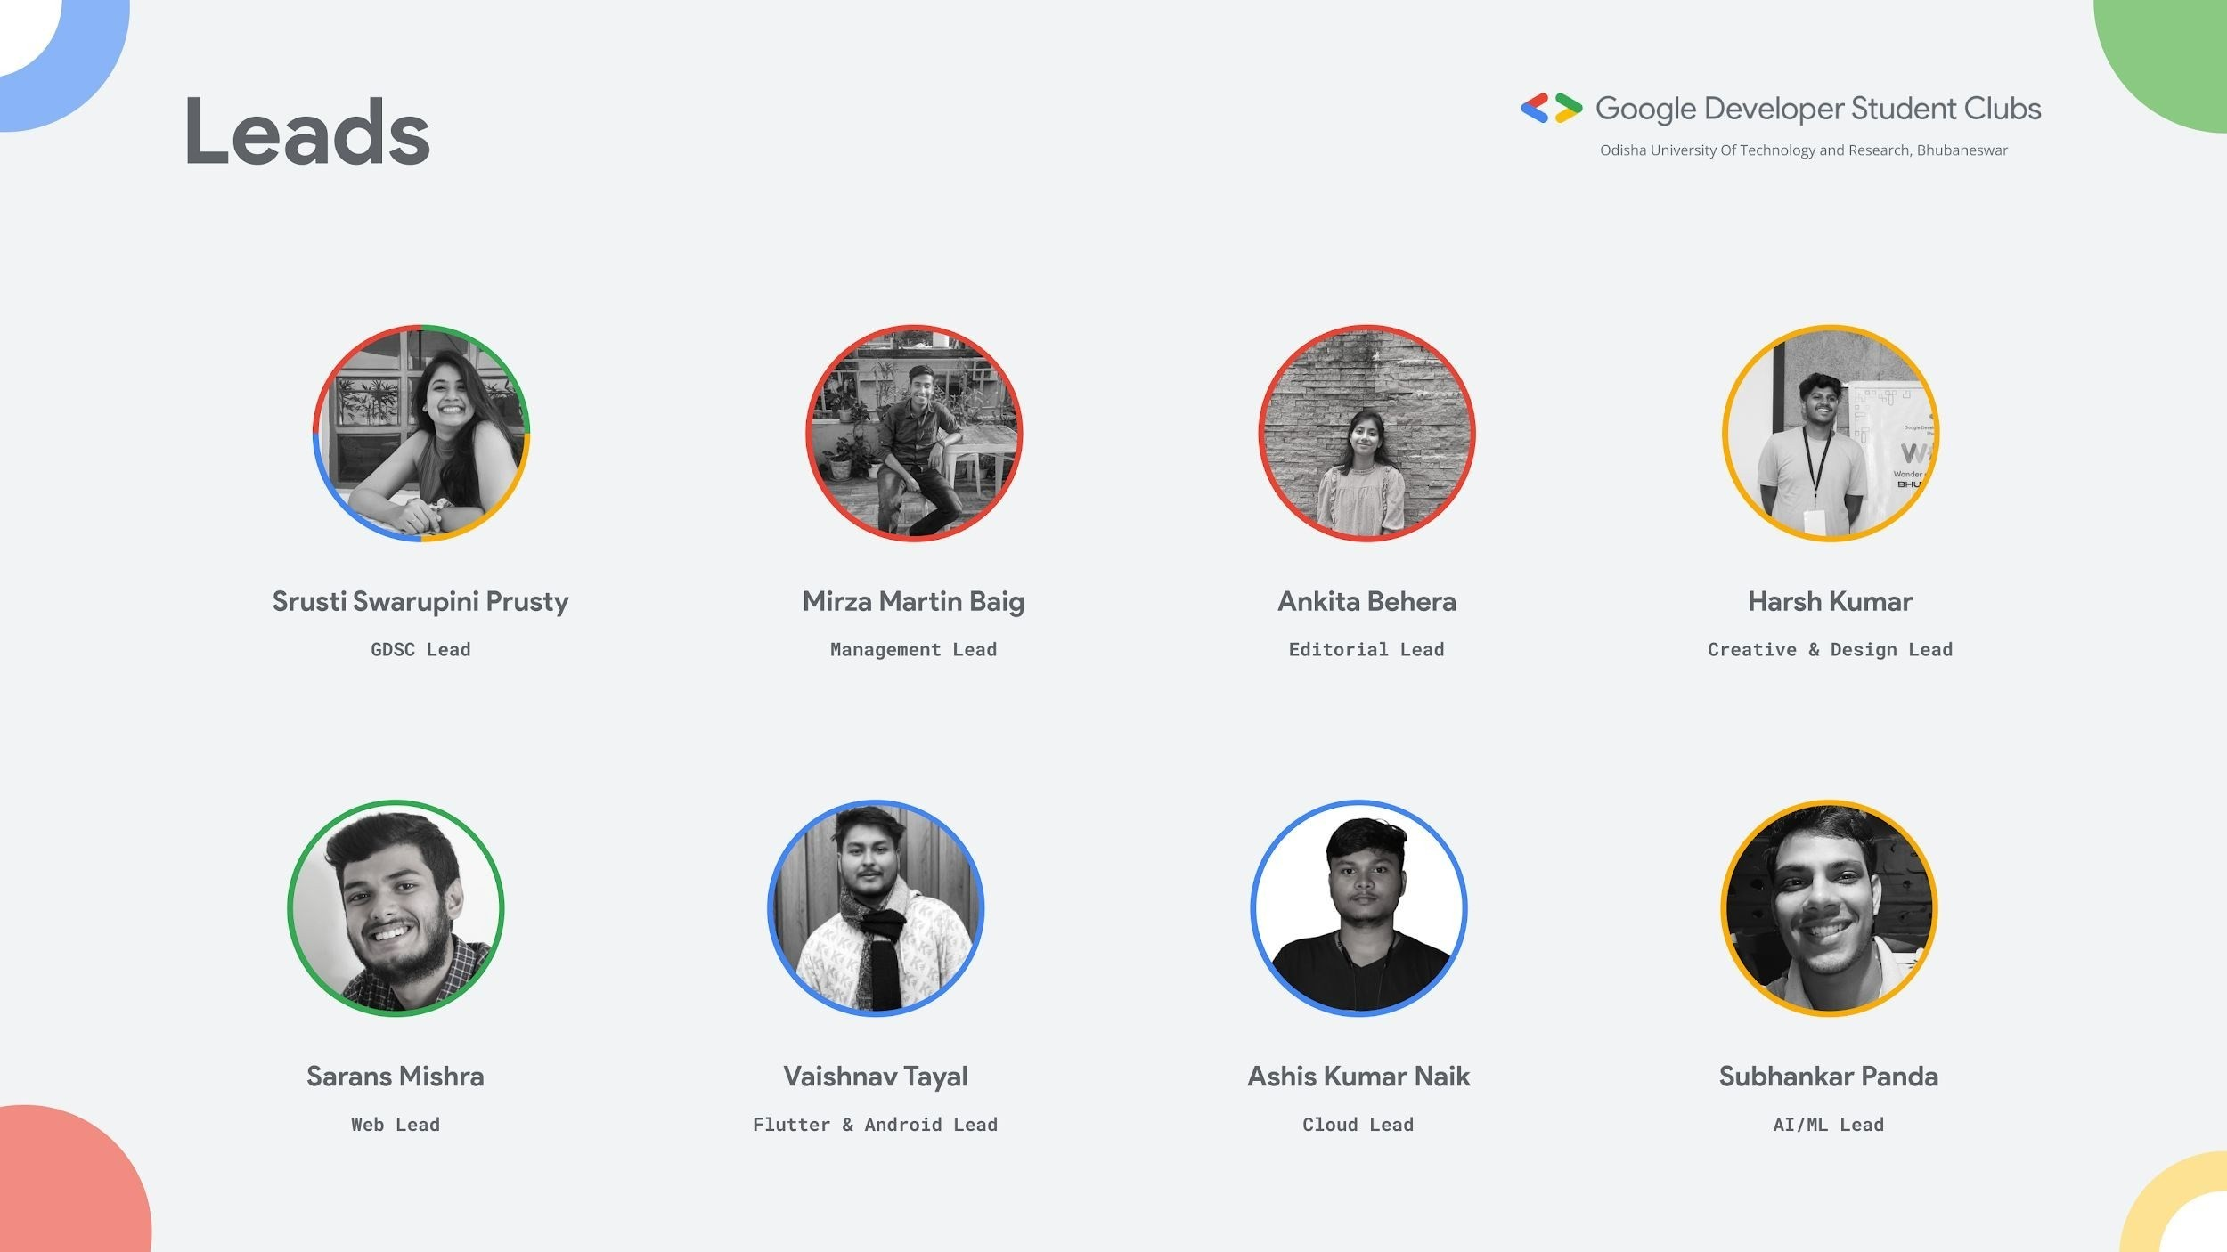

VERSION CONTROL SYSTEM
A version control system (VCS) is like a smart tool that helps people work together on projects, especially computer programs.
It keeps track of changes made to files, kind of like saving different versions of a document.
It's like having a time machine for your work!
www.codeboosters.in

Slide 3
DID YOU KNOW?
!=
GIT
GITHUB
www.codeboosters.in

Slide 4
WHAT IS GIT?
GIT is a CLI (Command Line Interface) based tool which is used for taking snapshots of each and every version of your code.
GIT is like an all rounder in a team , if you mess up GIT is there to cover up.
GIT can go back in time , can save your work repeatedly and many more. It is by far most used tools by the developers.
www.codeboosters.in

Slide 5
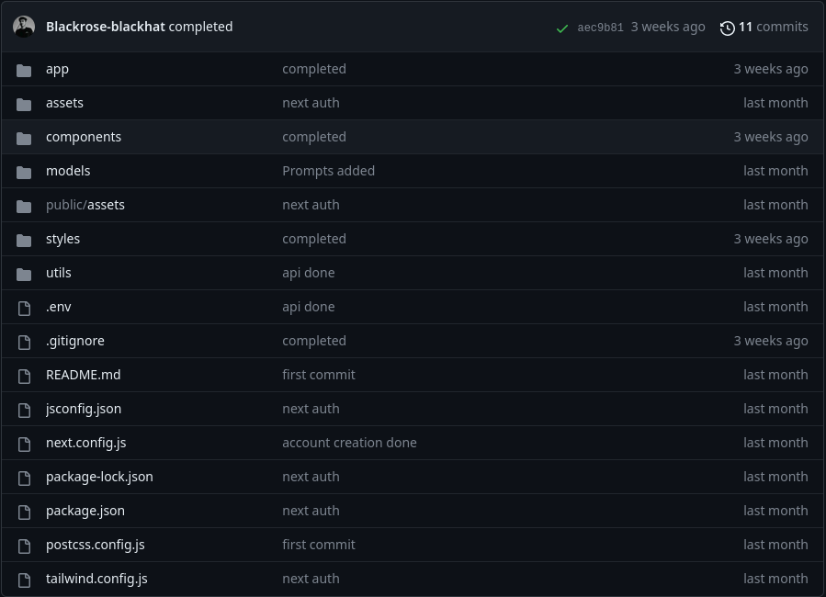
REPOSITORIES
Repo = Repository.
A folder like Structure containing all your necessary files .
Can contain folders,images,files, etc. , anything you want.
www.codeboosters.in

Slide 6

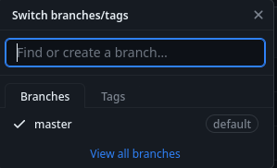
BRANCH
The branch concept in GIT is like You can create a branch to work on new features or fix issues without disrupting the main code.
If your changes in the branch are good, you can merge them into the main code. If not, you can make improvements without affecting the main codebase.
www.codeboosters.in

Slide 7
COMMIT
A commit is a snapshot of the changes made to the files in the repository at a specific point in time.
Commits store information about what was changed, who made the change, and when it was made.
www.codeboosters.in

Slide 8
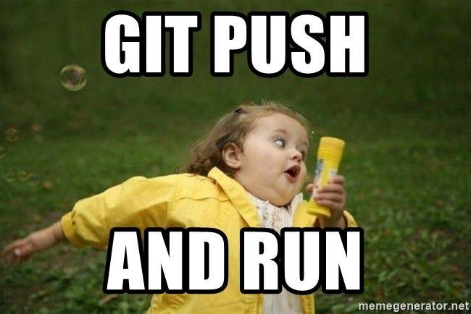
PUSH
The git push command is used in Git to upload your local commits and changes to a remote repository.
It's like uploading your work to the cloud so that your teammates or collaborators can access it.
www.codeboosters.in

Slide 9

PULL
The git pull command is used in Git to synchornize the changes made by others in your code.
It’s like merging two codespaces in one.
www.codeboosters.in

Slide 10
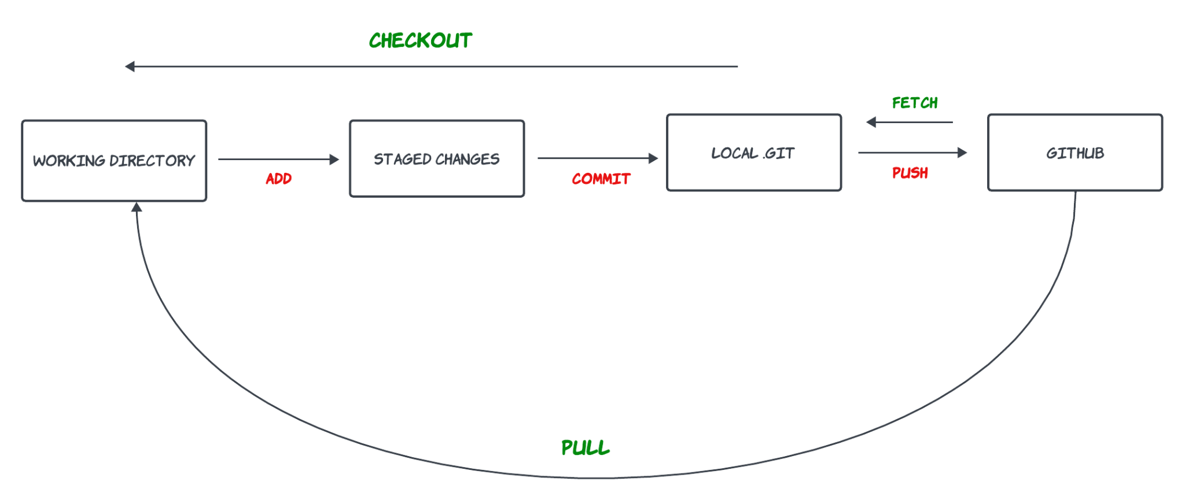
WORKFLOW OF GITHUB
www.codeboosters.in

Slide 11
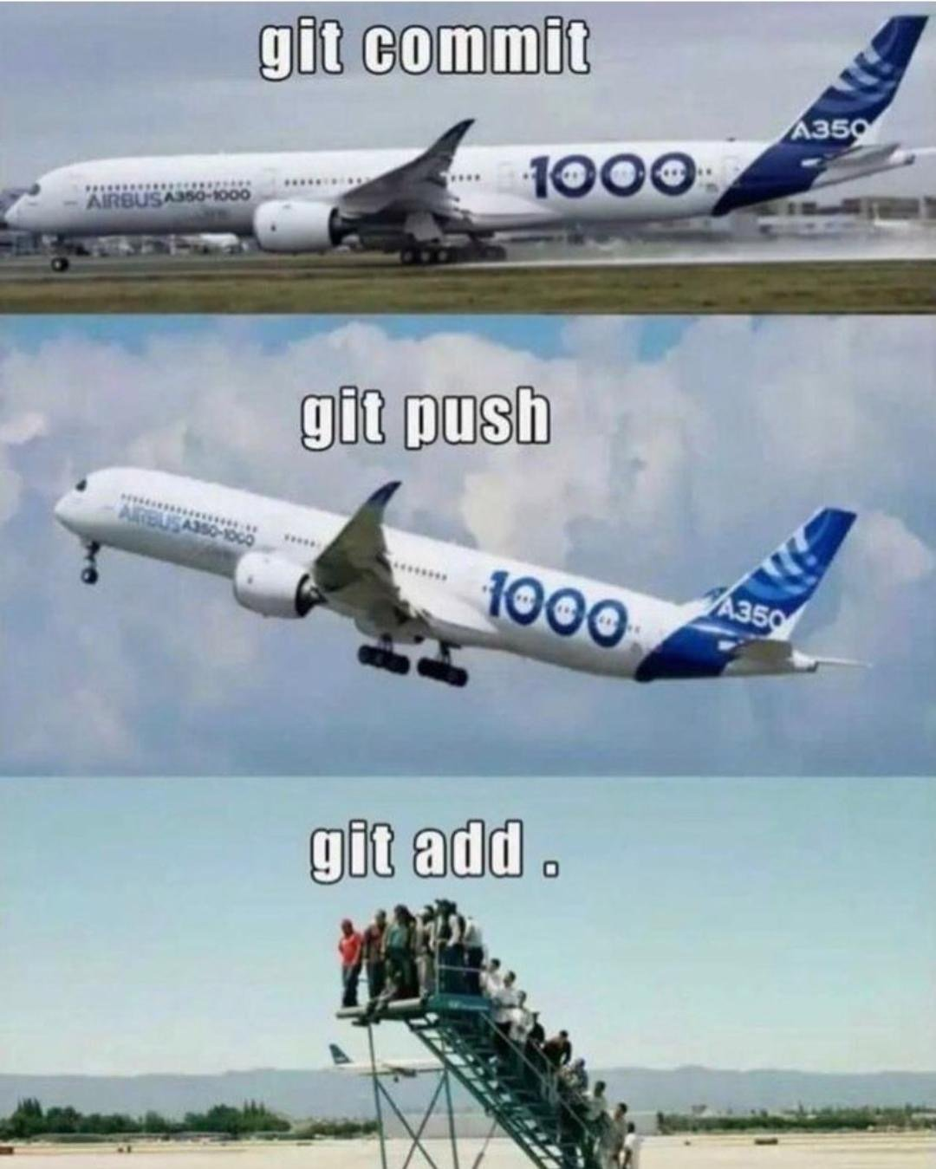
WORKFLOW OF GITHUB
www.codeboosters.in

Slide 12
QUICK DEMO
Setting up git on Windows.
Configuring GIT for windows.
Creating a Github Account.
Initializing a repo
Pushing the code to a repo.
www.codeboosters.in

Slide 13
GITHUB
Github is a web based platform that provides a space where we can collaborate on different projects.
We can suggest changes to a repo and also we can take references for our own code.
www.codeboosters.in

Slide 14
FORK
Fork is making a copy of a repository into your own GitHub account.
You can then do any changes or experiments in that code , that won’t be reflected in the original code .
If you think that your code is better than the original code you can create a PULL REQUEST (PR) to the original code.
www.codeboosters.in

Slide 15
PULL REQUESTS (PR)
A pull request is like asking your team to look at the changes you've made in your separate version of the project and consider adding those changes to the main project if they're good and ready.
If they feel good about your work they can merge your code with theirs.
If they don’t like it they can discard and close the PULL REQUEST (PR)
www.codeboosters.in

Slide 16
QUICK DEMO
Forking a Repo
Cloning
Making changes
Making PULL REQUESTS (PR)
Accepting PULL REQUEST (PR)
www.codeboosters.in

Slide 17
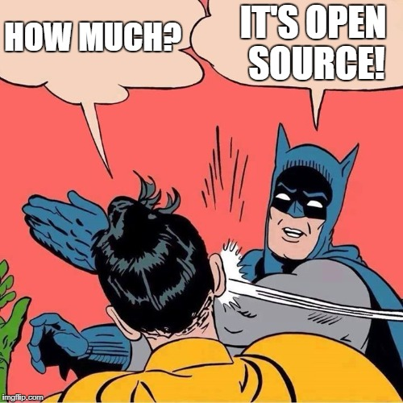
OPEN SOURCE DEVELOPMENT
What is open source?
Software whose source code is made available to the public, allowing anyone to view, use, modify, and distribute it.
Key Features:
Transparency,community-driven development, and freedom to customize.
www.codeboosters.in

